Slide 1
COMPUTATIONAL GEOMETRY

Slide 2
Input
  A set of points, a set of line segments, or the vertices of a polygon in counterclockwise order.
Output
  whether any of the lines intersect
  Finding the smallest enclosing convex polygon of the set of points.

Slide 3
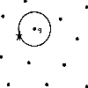
Overview
Line Segment Intersection
Convex Hull Algorithms
Nearest Neighbors/Closest Points

Slide 4
Line Segment Intersections
(2D)
  Intersection of 2 Line Segments
  Intersection of > 2Line Segments

Slide 5
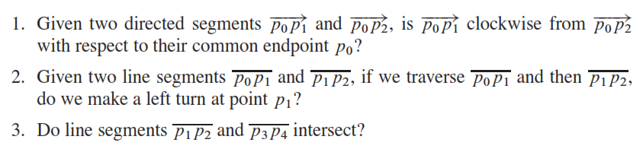
Cross-Product-Based
Geometric Primitives
Some fundamental geometric questions:
p₂
p₃
p₃
p₂
p₁
p₂
p₄
p₀
p₁
p₁
(1)
(2)
(3)

Slide 6
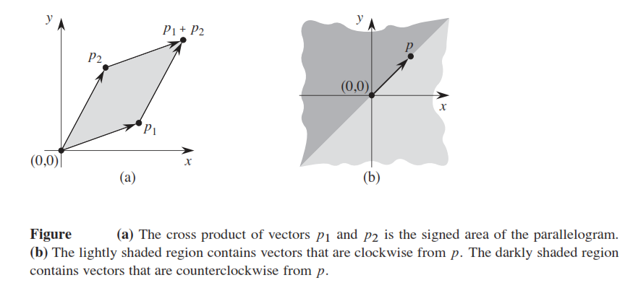
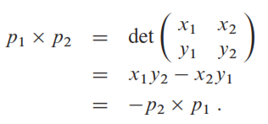
Cross-Product-Based Geometric Primitives
p₂
33.1
p₁
p₀
(1)

Slide 7
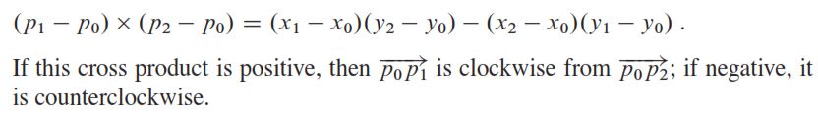
With respect to Origin (0,0)
p₁xp₂ = x₁y₂-x₂y₁
With respect to a point p₀ (x₀,y₀)
If cross product is 0 then they are colinear

Slide 8
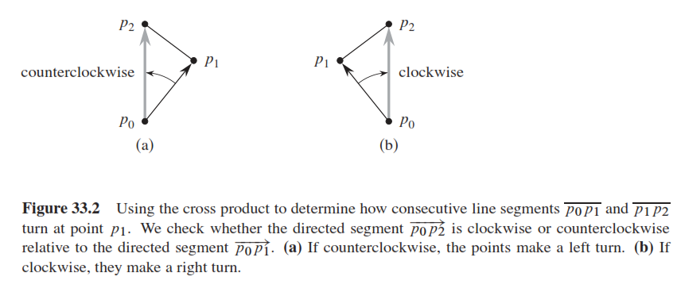
Cross-Product-Based Geometric Primitives
p₂
p₁
33.2
p₀
(2)
If the cross product is negative, then p_{o}p₂ is counterclockwise with respect to p₀p₁, else if it is positive then p_{o}p₂ is clockwise with respect to p₀p₁, if it is zero then they are colinear.

Slide 9
Intersection of 2 Line Segments
A segment p₁p₂ straddles a line if point p₁ lines on one side and the point p₂ lies on the other side.
Two line segments intersects if and only if either or both of the following conditions holds:
  Each segment straddles the line containing the other
  An endpoint of one segment lies on the other segment (boundary case)
33.3

Slide 10
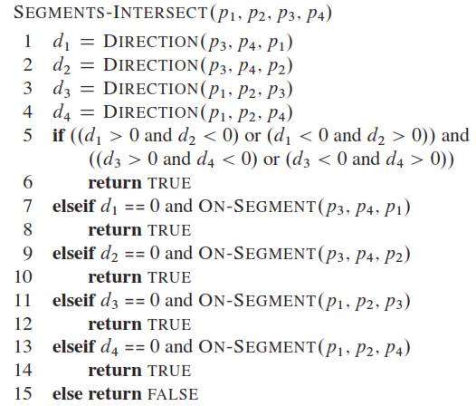

Slide 11
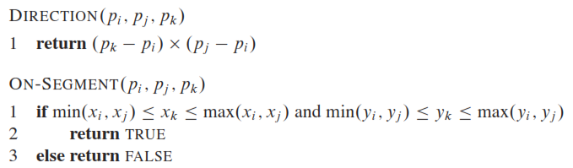

Slide 12
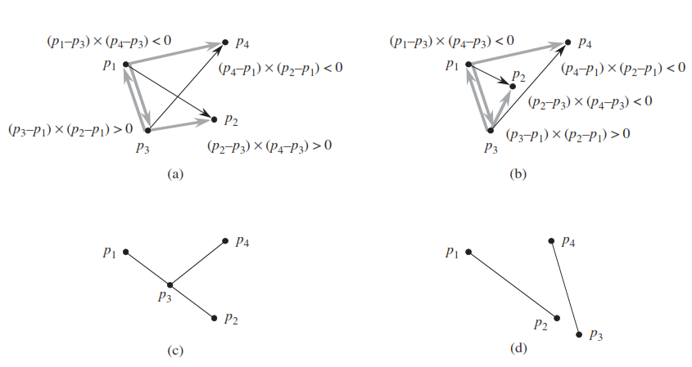
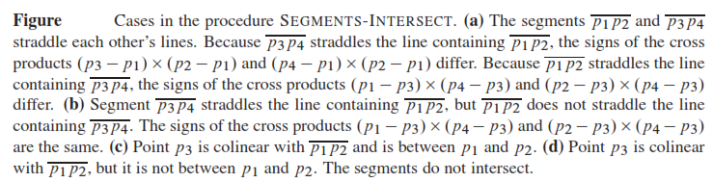

Slide 13
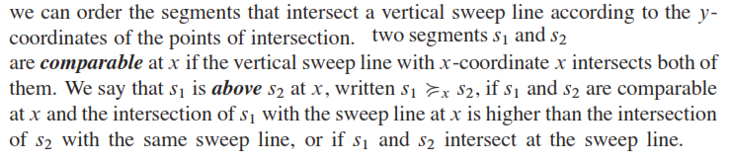
Of n line segments determining whether any two line segments intersects
Sweep Line
  An imaginary vertical line that passes through the geometric shapes from left to right in x-axis direction
Assumptions
  No input segment is vertical.
  No three input segments intersect at a single point.

Slide 14
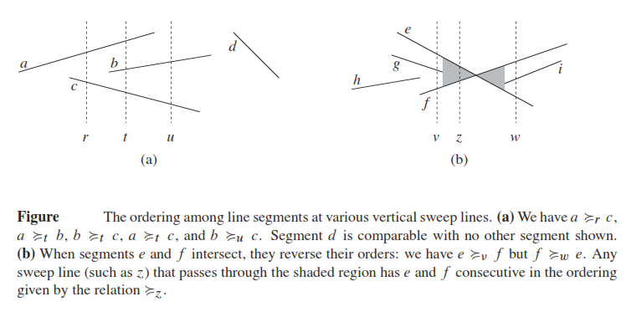
Intersection of >2 Line Segments
33.4

Slide 15
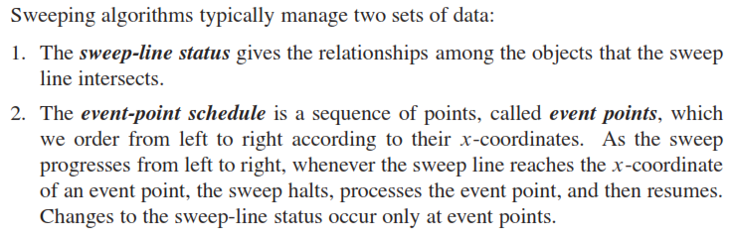
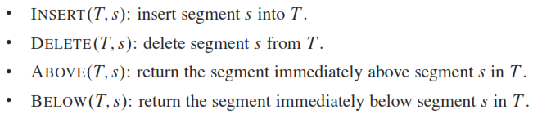
Intersection of >2 Line Segments

Slide 16
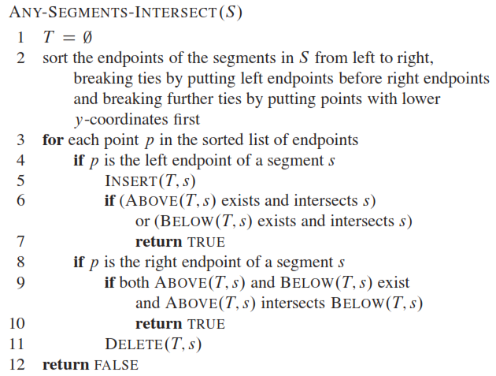
33.5

Slide 17
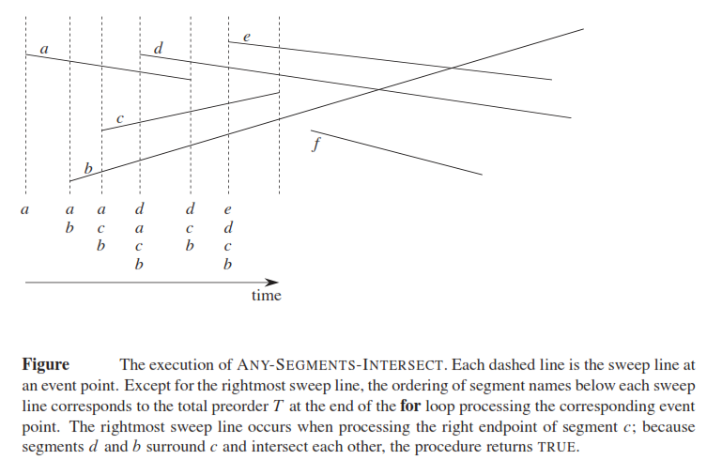

Slide 18
Convex Hull Algorithms

Slide 19
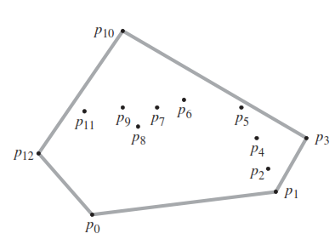
Convexity & Convex Hulls
Convex hull of a set of Q of points, denoted by CH(Q), is the smallest convex polygon P for which each point in Q is either on boundary of P or in its interior.
Methods
  Rotational Sweep
  Incremental Method
  Divide and Conquer
  Prune and Search
Algorithms
  Graham’s Scan Algorithm using Rotational Sweep - O(n lg n)
  Jarvis’s March using Gift Wrapping O(nh)

Slide 20
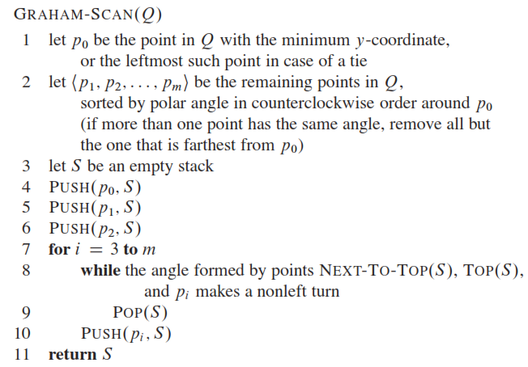
Graham Scan Algorithm

Slide 21
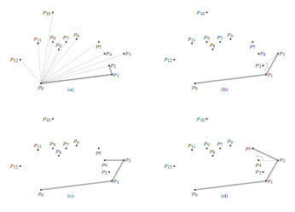
Graham Scan

Slide 22
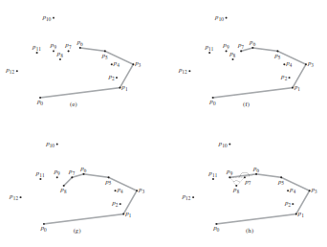
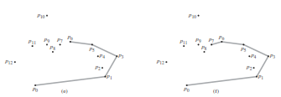

Slide 23
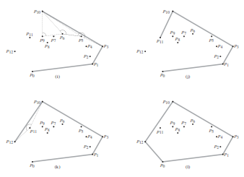

Slide 24
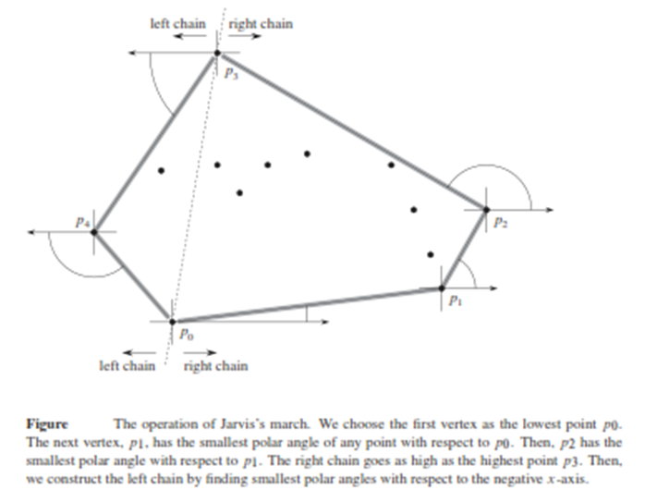
Jarvis March

Slide 25
Nearest Neighbor/
Closest Pair of Points

Slide 26
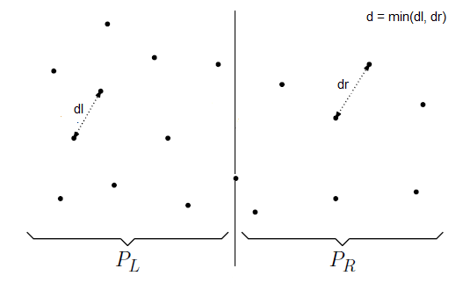
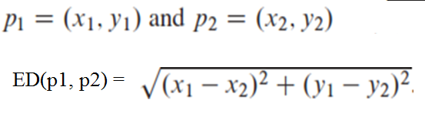
Closest Pair

Slide 27
Closest Pair – Divide and Conquer
Divide the set into two equal sized parts by the line l, and recursively compute the minimal distance in each part.
Let d be the minimal of the two minimal distances.
Eliminate points that lie farther than d apart from l
Sort the remaining points according to their y-coordinates
Scan the remaining points in the y order and compute the distances of each point to its five neighbors.
If any of these distances is less than d then update d.

Slide 28
Algorithm Closest Pair(P, X, Y)
P = Set of points, X = Points sorted by increasing x, Y = Points sorted by increasing y
If |P| <= 3 then
  Let d₁ = ED(p₁, p₂), d₂ = ED(p₂, p₃), and d₃ = ED(p₁, p₃)
  Return min(d₁, d₂, d₃)
Else
  Find the middle point (l, c) in X and split the points P into two halves P_{L} and P_{R} with respect to the vertical line x=l, array into two halves X_{L} and X_{R}
  Split the Y array into Y_{L} and Y_{R} such that for each pϵY insert into Y_{L} if it is in X_{L} or else into Y_{R}
  d_{L} = ClosestPair(P_{L}, X_{L}, Y_{L})
  d_{R} = ClosestPair(P_{R}, X_{R}, Y_{R})
  Let d = min(d_{L}, d_{R})
  P’ = FindPoints(P, X, Y, d, l)
  compute the distance between every pair of points in P’ (at most 7 points). Let the minimum be d_{C}.
  If d_{C} < d then return d_{c} else return d

Slide 29
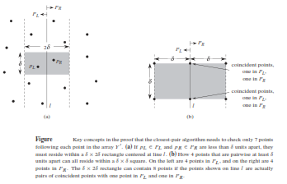
33.11

Slide 30


Splitting Y array in sorted order

